Slide 1
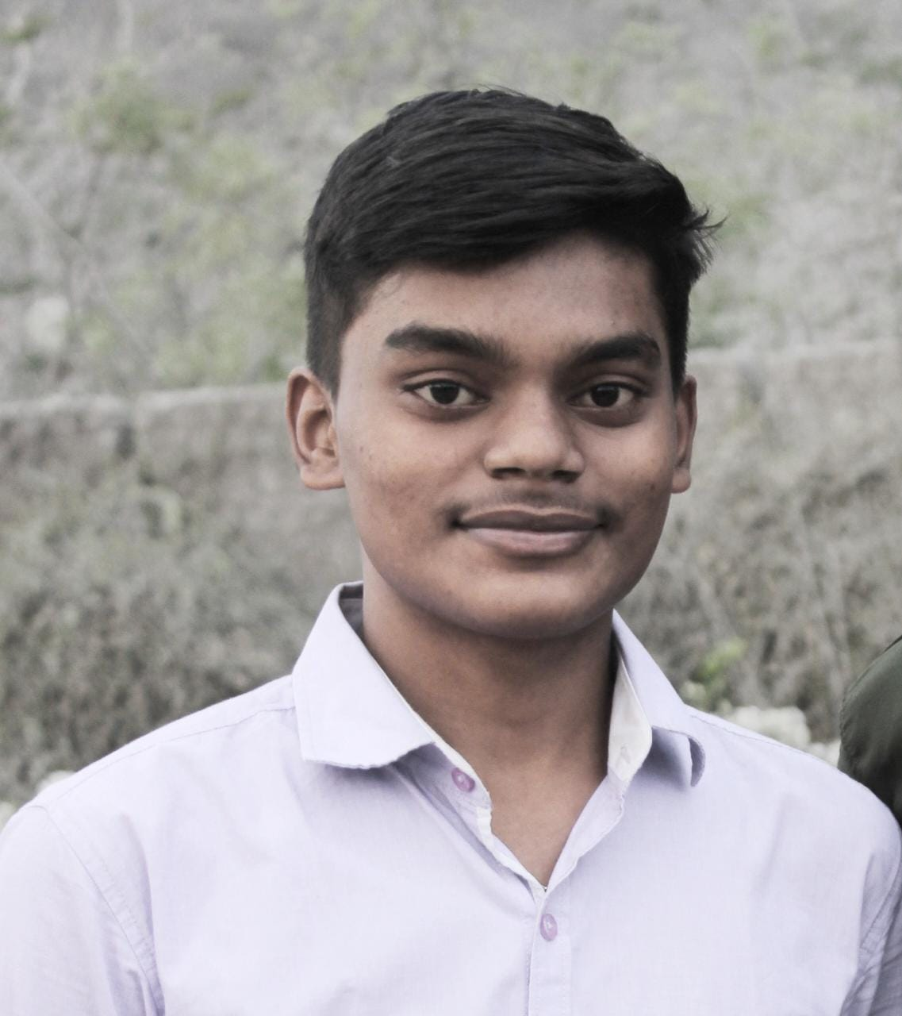
Student Details
Name: SAI RAGHAVA DINESH.BT
Smart Bridge Email ID: 20981a4915@raghuenggcollege.in
College Name: Raghu Engineering College
College State: Andhra Pradesh
Internship Domain: Front-End Development

Slide 2
PROJECT TITLE: CREATING A PORTFOLIO SITE
• In this project we will handle with the Front-End Frameworks to design the Portfolio site.
•To create a basic website we will deal with HTML,CSS. To move advance level we will go with the JavaScript and ReactJS at some situations based on the user requirement.
• To develop Portfolio site we need to use the above frameworks along with an editor required such as Visual Code Studio or Sublime Text as per our convenience.

Slide 3
AGENDA
• In this project we mainly cover the Frameworks like HTML,CSS and JavaScript where one can implement any frontend websites using them.
• I used Bootstrap icons and imported external fonts which helps in making the website looks unique.
• I implemented various CSS libraries to make the website look handy and get attention from the user while using it.
• I used Display Flex for creating the navbar and skill bar to represent the skills that are acquired in a creative way.

Slide 4
PROJECT OVERVIEW
• A portfolio is a collection or compilation of work samples, achievements, skills, and experiences that showcase an individual's or organization's abilities, expertise, and accomplishments in a specific field or industry
• Front-End Web Development Portfolio Website is the output of the skills learned during the Smart Bridge Internship.
•The Website Comprises of About, Skills Acquired, Portfolio and Contact to provide a detailed view to the user.

Slide 5
END USERS OF THE PROJECT
• Potential Employers: Recruiters and Hiring managers seeking talented front-end web developers.
• Clients: Individuals or Organizations looking for Web Development services.
• Peers and Mentors: Fellow interns, mentors, and industry professionals who want to learn more about my skills and accomplishments.
• Visual Display: Portfolios typically allow users to present their work visually, using images, videos, or interactive elements.

Slide 6
YOUR SOLUTION AND ITS VALUE PROPOSITION
• My Portfolio Website is much clear and user friendly in its way , where one User/Recruiter can easily understand all the details that I have mentioned in my portfolio with a clear sliding representation of my skills and the beautiful alignment of projects that I have done.
• Portfolio website solution ensures that portfolios are optimized for different devices and screen sizes. This responsiveness enables users' portfolios to look visually appealing and function seamlessly on desktops, tablets, and mobile devices.
• It demonstrates my technical skills, creativity, and attention to detail, which can attract potential employers, clients, and collaborators.

Slide 7
HOW DID YOU CUSTOMIZE YOUR PROJECT AND MAKE IT YOUR OWN
• I implemented About section where it includes the basic and academic details of mine, along with that I have also included my technical skills under the Skills Acquired section with a skill bar notation which attracts as a main aspect in my portfolio website.
• I also implemented a Portfolio section where all my projects that are done during my Bachelor's period were mentioned in a neat and uniform way where one can easily go through the work that I have done in my Bachelor's period.
•I have used Display Flex to represent my website much unique from others and used many bootstrap methods to make my website much clear.

Slide 8
MODELLING
•I used media queries to make our portfolio website code responsive so in every device our portfolio loads with the same design with no layout shifting.
• I used Display Flex to represent my website very attractive to any Users/Recruiters.
• I Have taken Bootstrap Website as a reference to implement my website with various icons.
• I used Google Fonts for creating my website with an attractive font.

Slide 9
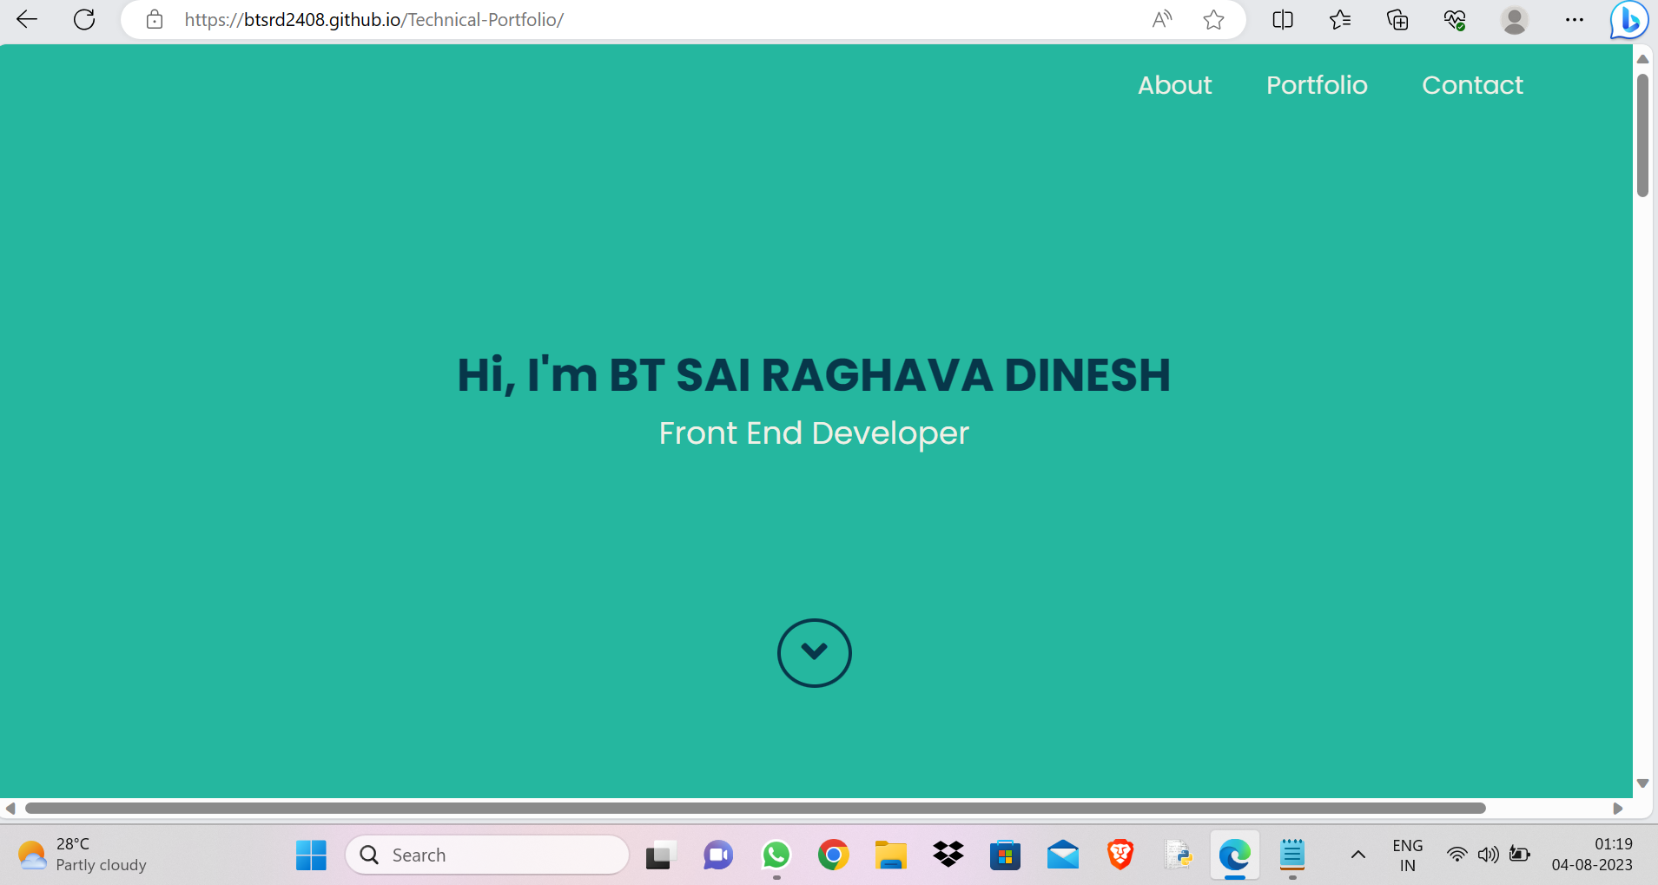
RESULTS

Slide 10
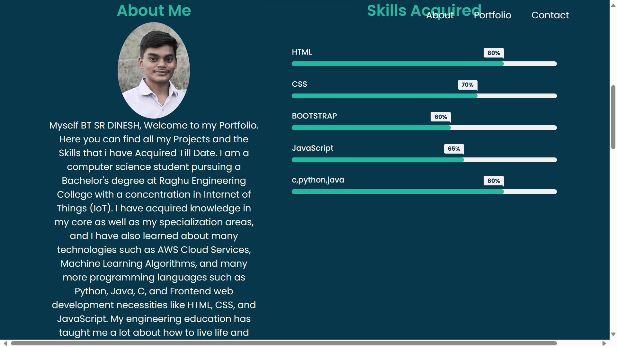
RESULTS

Slide 11
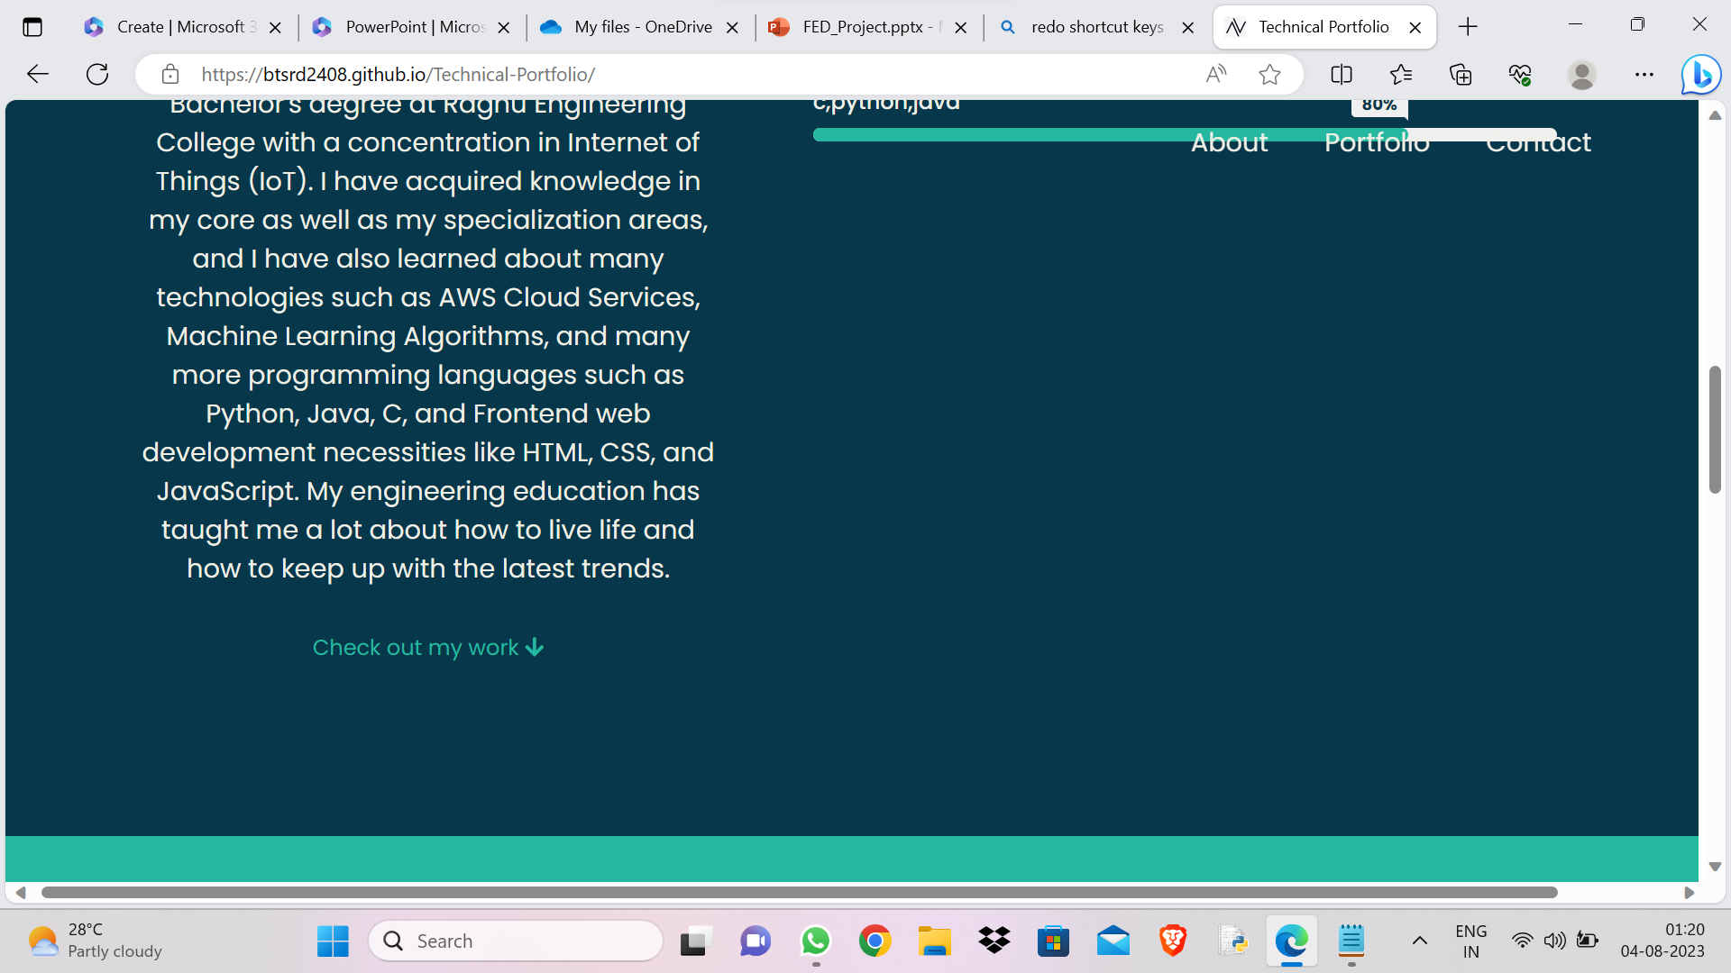
RESULTS

Slide 12
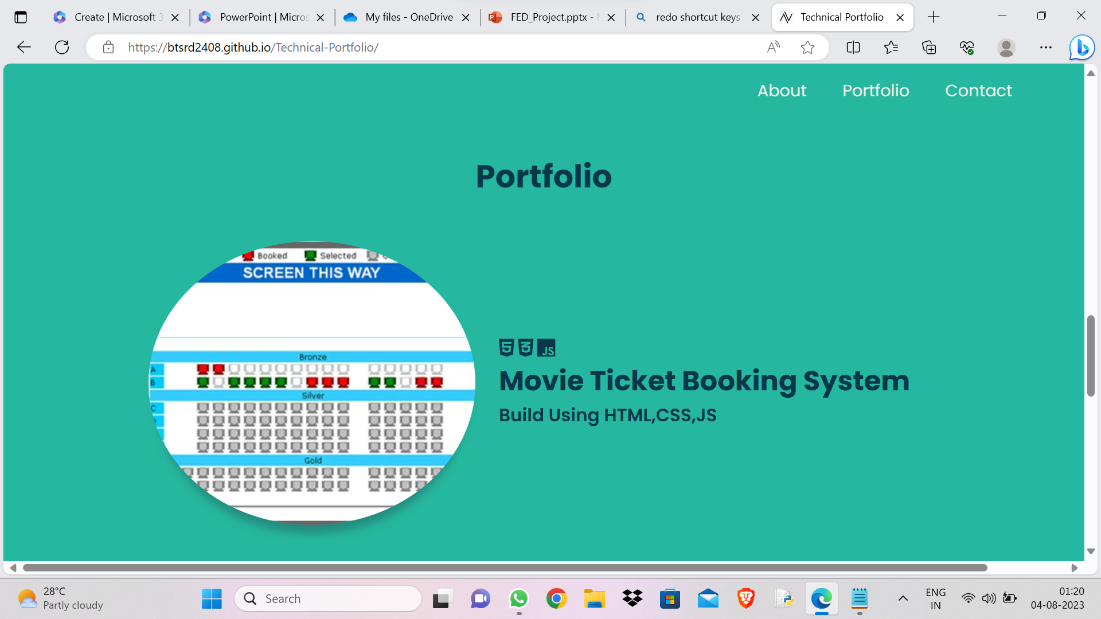
RESULTS

Slide 13
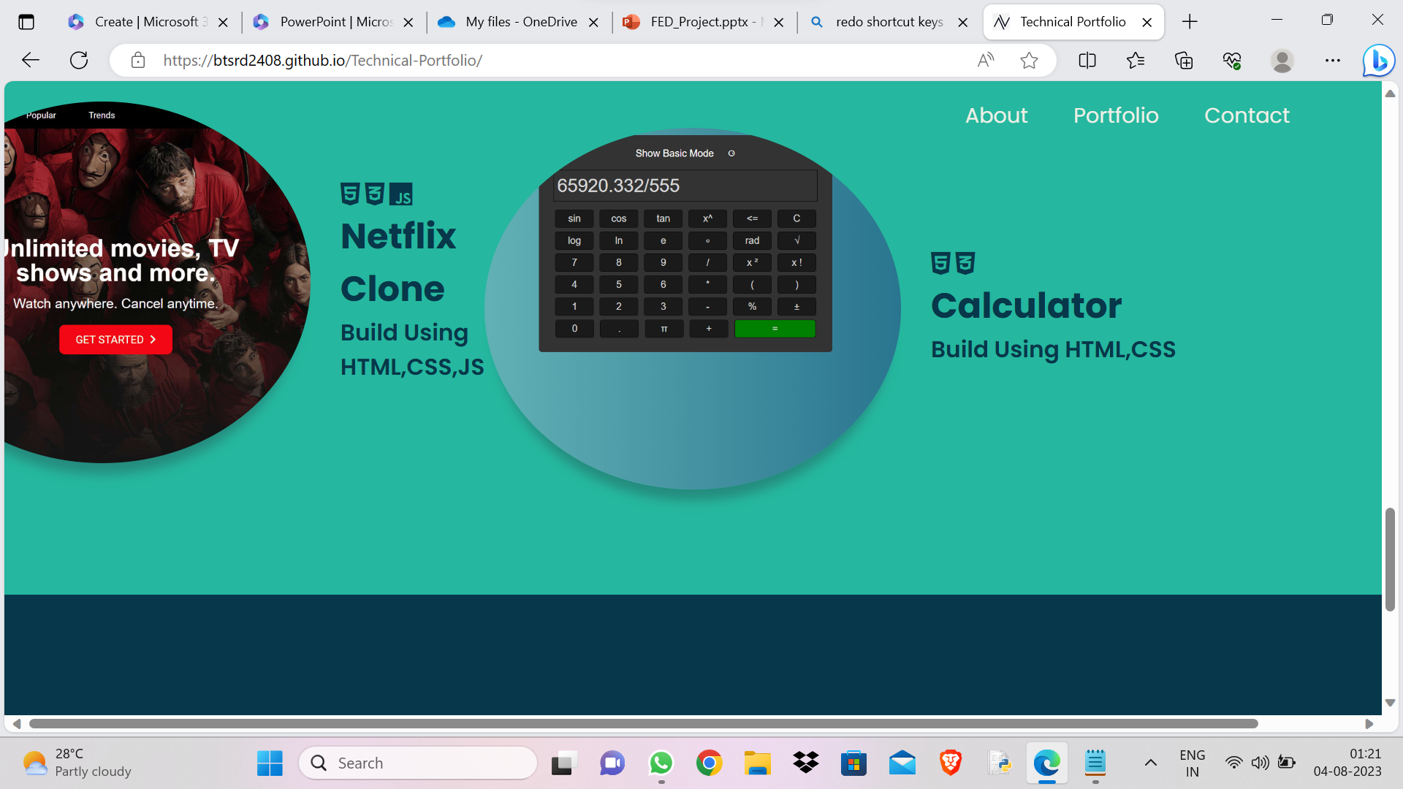
RESULTS

Slide 14
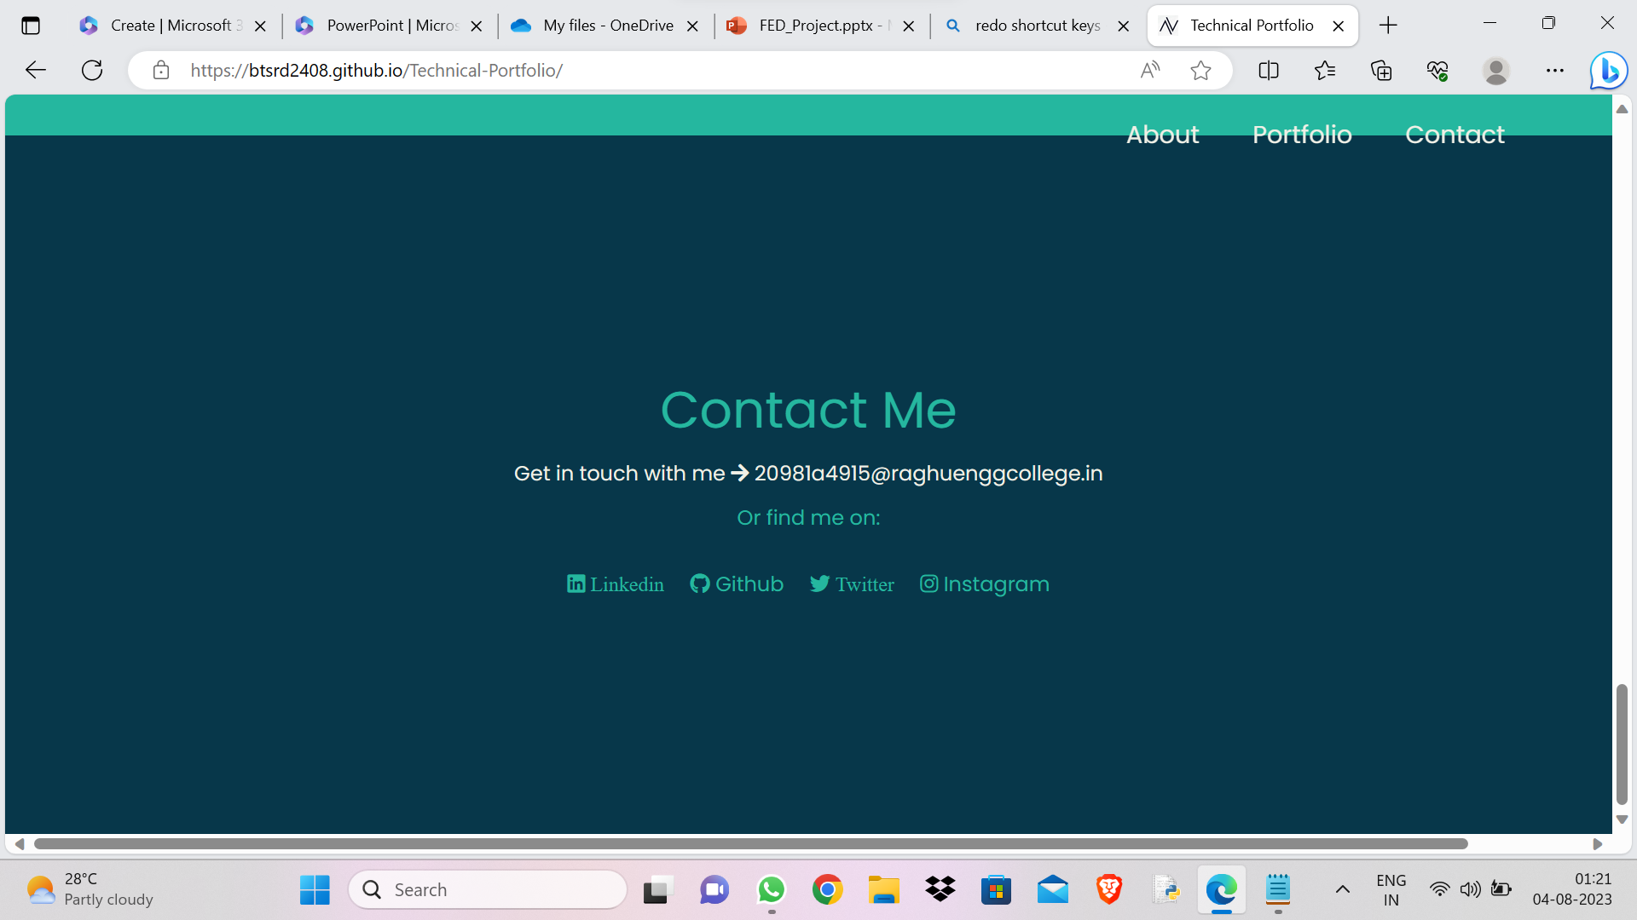
RESULTS

Slide 15
LINKS
Below is my GitHub Link, it redirects to my GitHub Account, Where you can find my Project.
https://github.com/btsrd2408/Technical-Portfolio.git
Below is my Project Website Link, through this you can Experience my Portfolio Website.
lhttps://btsrd2408.github.io/Technical-Portfolio/

